Slide 1

Bitcoin / Blockchain Landscape

Slide 2




What is Bitcoin?
Bitcoin is a crypto-currency, meaning it relies on mathematical encryption rather than a central bank for regulation.
Bitcoins are virtually impossible to duplicate or forge due to incredibly complicated mathematical encryption.
Bitcoins circulation is completely digital. Completely peer to peer. That means instant, untraceable transmissions with no middleman.
Proprietary and Confidential
3

Slide 3

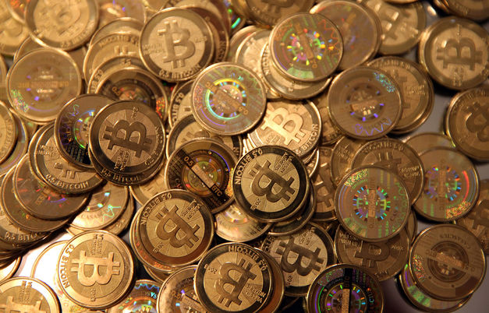
What is Bitcoin?
Bitcoins can be traded across borders with no interference-24/7/365, Bitcoin is Live. Bitcoins can be exchanged for any global currency.
21 Million Coins in existence only 15 million mined.
More than 6 billion USD in circulation.
Proprietary and Confidential
3

Slide 4
Industry Quotes
"Virtual Currencies may hold long-term promise, particularly if the innovations promote a faster, more secure and more efficient payment system.” " - Ben Bernanke, Chairman of the Federal Reserve
"Virgin Galactic is a bold entrepreneurial technology. It's driving a revolution and Bitcoin is doing just the same when it comes to inventing a new currency." - Sir Richard Branson, Founder of Virgin Records, Virgin Galactic, and 400+ other businesses
"Bitcoin is a remarkable cryptographic achievement and the ability to create something that is not duplicable in the digital world has enormous value" - Eric Schmidt, CEO of Google
"I think the fact that within the Bitcoin universe an algorithm replaces the functions of [the government] … is actually pretty cool. I am a big fan of Bitcoin" - Al Gore, 45th Vice President of the United States
"Bitcoin will do to banks what email did to the postal industry" - Rick Falkvinge, Founder of the Swedish pirate party
"Bitcoin is a techno tour de force." Bill Gates, Founder of Microsoft
Proprietary and Confidential
3

Slide 5











Bitcoin Acceptance
Over 120,000 Merchants Now Accept Bitcoins,
ASIA
Proprietary and Confidential
2

Slide 6
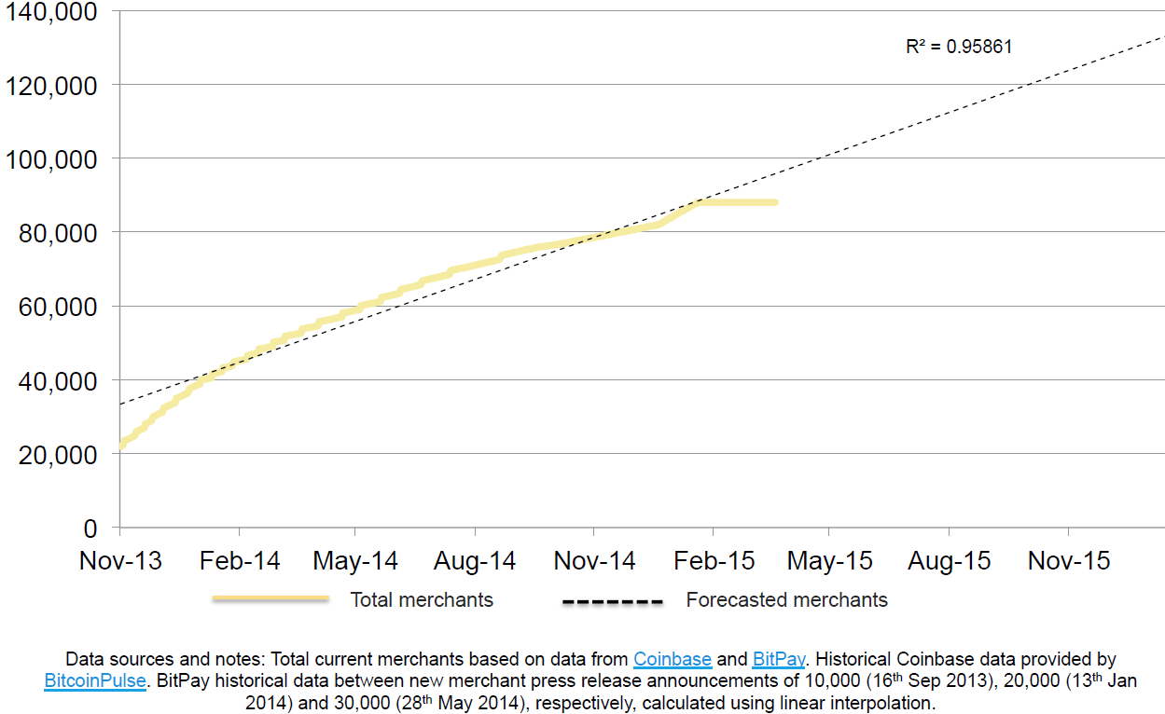
Bitcoin-Accepting Merchant Forecast Slashed to Approximately 120,000 by End of 2015
Proprietary and Confidential
3

Slide 7
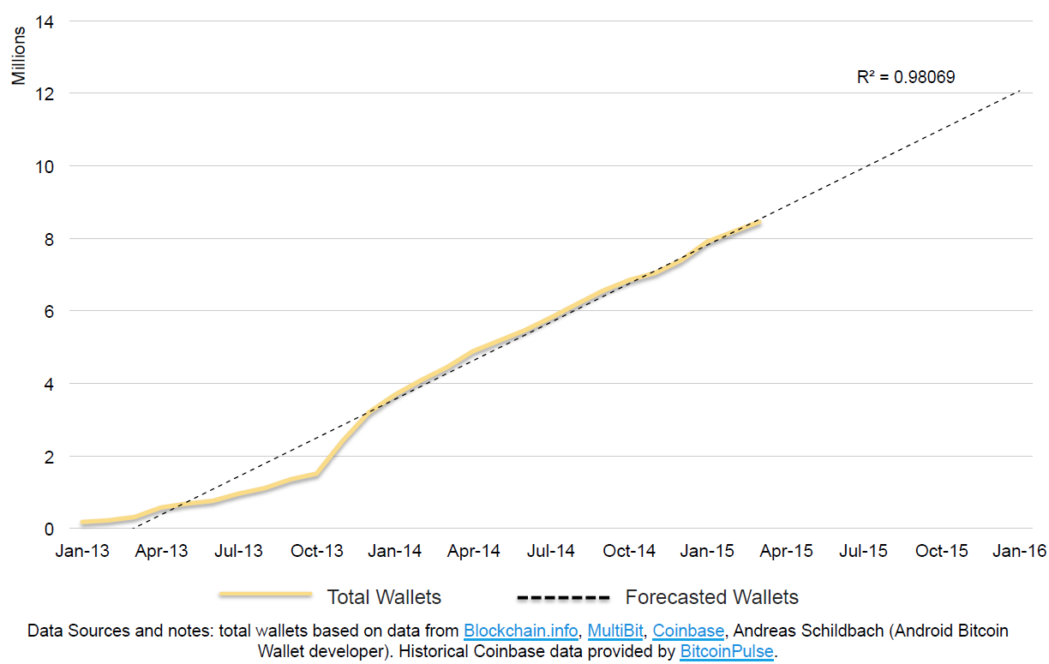
Forecast for Total Bitcoin Wallets by End of 2015 Maintained at 12 million
Proprietary and Confidential
3

Slide 8


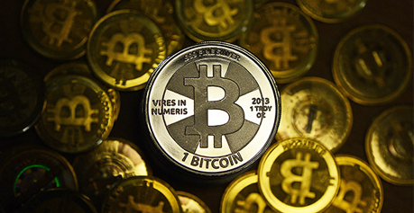
What is Bitcoin Mining?
Bitcoins are created through transactions made between buyers and sellers world wide.
Miners use special software to solve complex math problems and are issued a certain number of Bitcoins in exchange. This provides a smart way to issue the currency and also creates an incentive for more people to mine.
The miner is rewarded a Bitcoin when he adds a block to the “blockchain”.
Proprietary and Confidential
3

Slide 9
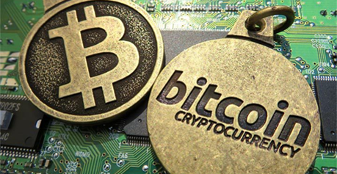

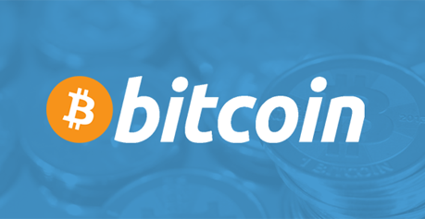
What is Bitcoin Mining?
Each transaction has to get approved by a “miner” who is separate from the buyers and sellers.
Once the miner approves the transaction, he connects it with other transactions that he has also approved until he has enough to add it to his “blockchain”.
Bitcoin mining is how Bitcoins are securely generated.
Proprietary and Confidential
3

Slide 10
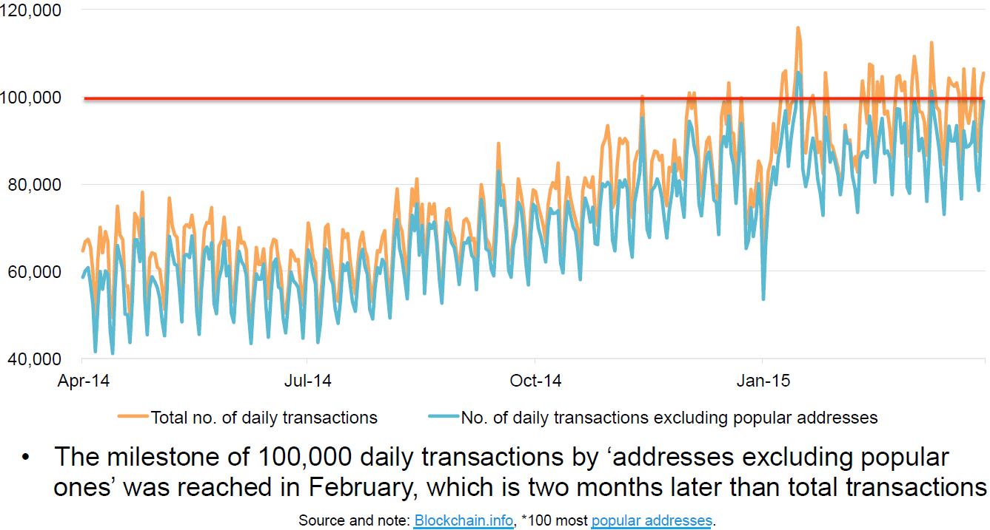
Number of Transactions per Day
Bitcoin Transactions Have Been Rising; Average of 10,000 Daily Transactions by Popular Addresses*
State of Bitcoin Q1 2015
Proprietary and Confidential
3

Slide 11
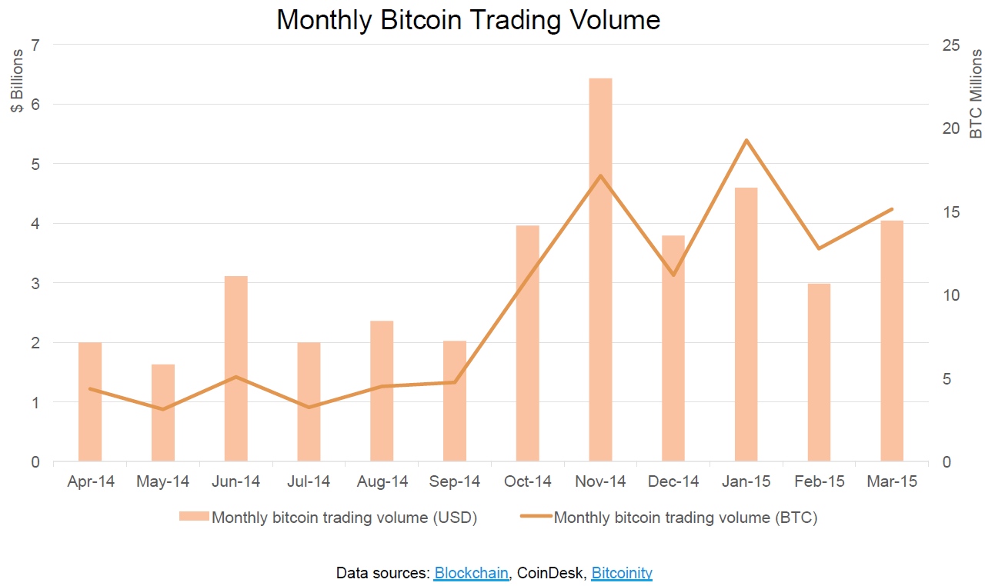
Monthly Bitcoin Trading Volume
Bitcoin’s Growing Exchange Trading Volume is Trending Up
Proprietary and Confidential
3

Slide 12
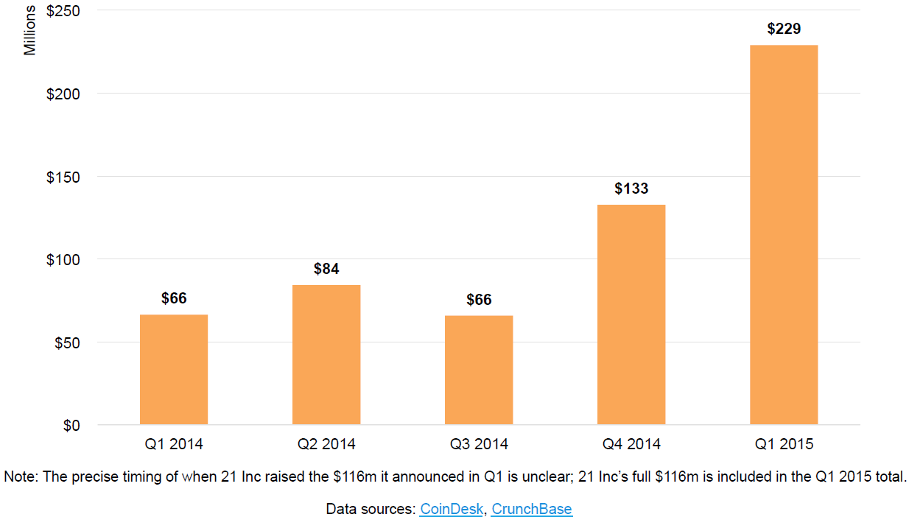
Quarterly Total VC Investment (USD Millions)
Q1 Set a Record for Bitcoin Venture Capital Investment, Nearly Doubling Q4 2014
Proprietary and Confidential
3

Slide 13

VC Transactions
Q1 was Bitcoin’s largest VC investment quarter yet with $226m raised; all-time Bitcoin VC investment now totals $676m.
21 Inc, which announced $116m in new funding, surpassed Coinbase as the best-capitalized Bitcoin startup.
Proprietary and Confidential
3

Slide 14
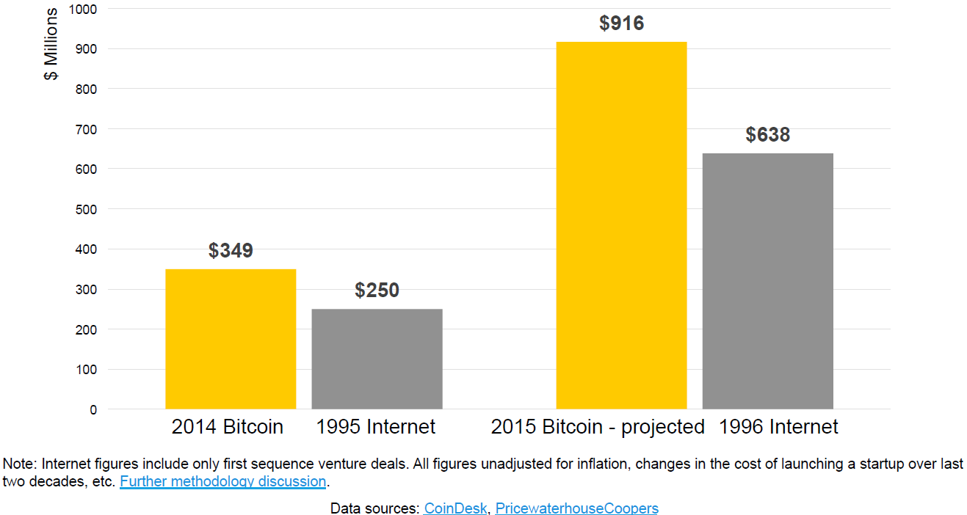
Bitcoin vs early Internet VC investment ($ millions)
Bitcoin VC Investment Projected to Continue Outpacing Early-Stage Internet Investment
Proprietary and Confidential
3

Slide 15
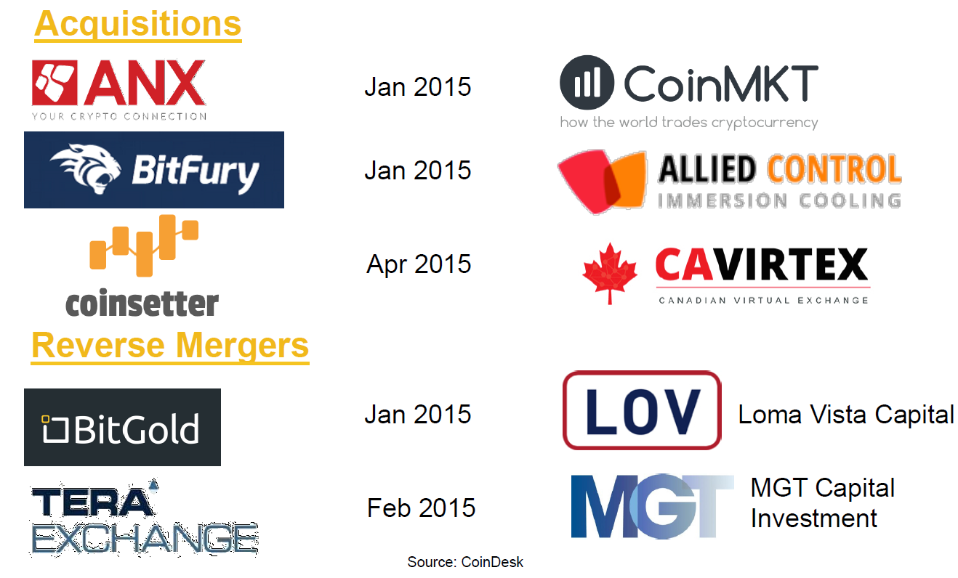
Q1 Deal Summary: Acquisitions and Reverse Merger Activity Accelerates
Proprietary and Confidential
3

Slide 16




Resent News Highlights
New York Just Issued Its First-Ever Bitcoin Banking License
Proprietary and Confidential
3

Slide 17
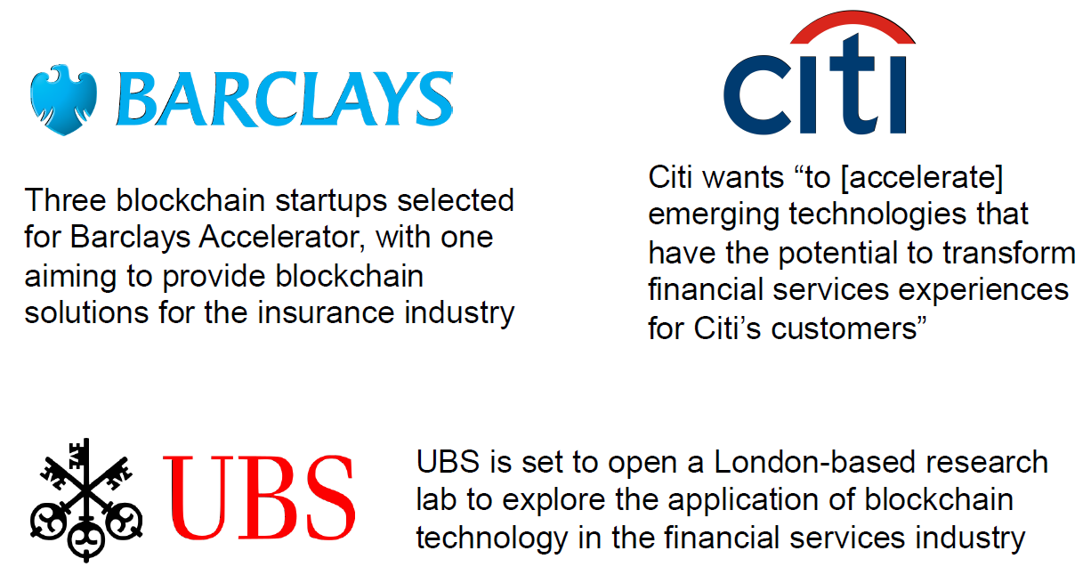
Wall Street Interest in Bitcoin is Growing
Proprietary and Confidential
3

Slide 18
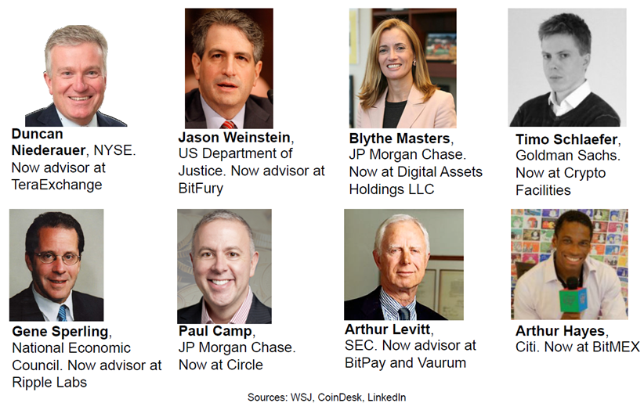
Migration of Wall Street Executives to Bitcoin Companies Continues
Proprietary and Confidential
3

Slide 19
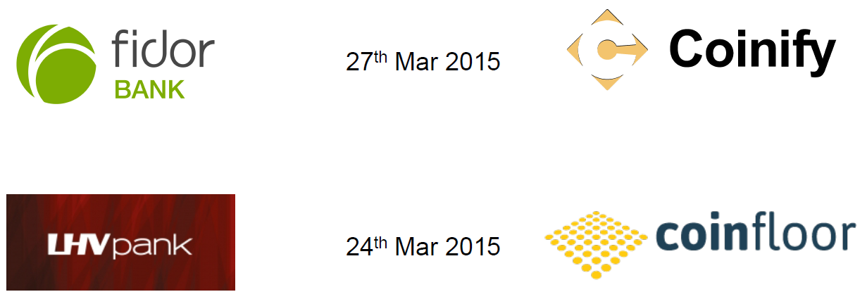
Newly Announced Banking Relationships
Nine Banks in Total Have Established Banking Relationships with Bitcoin Startups to Date
Securing banking partnerships has hindered the operations of Bitcoin companies, often forcing them to halt part of their offerings
However, partnership between banks and Bitcoin companies could improve security and efficiency
Proprietary and Confidential
3

